Slide 1
Higher Level Formations
How might we extend this:
to formations with large numbers, or
Formations with intricate patterns

Slide 2
Higher Level Formations
Create a formation of formations
Each slot contains a formation
formation is the “individual”
Useful in tactical simulations (RTS)
Individuals are placed in slots to form basic formations
Each formation has its own steering anchor point
Formations are assigned to slots in higher level formations
Each anchor point tries to stay in a slot position of a higher-level formation

Slide 3
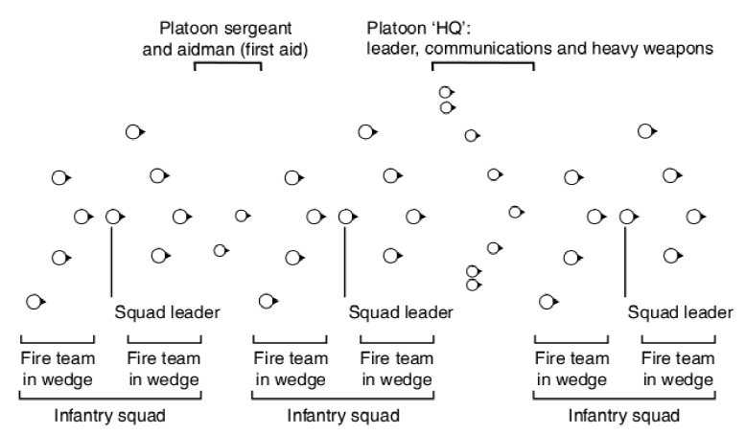
U.S. Infantry Soldiers
Note a squad formation has three slots that can be either a formation or individual
Notes:
Adapted from the U.S. infantry soldiers training manual.
Corps <- Division <- Brigade <- Battalion <- Company <- Platoon <- Squad

Slide 4
Slot Roles
Issues in assigning to slots
Who is allowed in what slot
Slots can have specific roles attached
Hard roles
Only NPC capable of performing role is allowed take slot
Makes filling slots more complex

Slide 5
Example – DnD
Three types of role
Melee
Barbarians, warriors, dwarves
Hand to hand combat (close range)
Missile
Elves, archers, etc.
Long range combat
Magic
Wizards, witches, etc.
Longest range combat

Slide 6
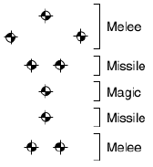
DnD – Example
In a formation we ideally want
Melee roles in front
Missile roles behind melee
Magic furthest away from action
Missile roles behind magic
Melee roles at rear

Slide 7
Hard Slot Roles
Assign slots based on type of NPC
But we can have many combinations of types in group
Have many different formations depending on group composition
May not be practical
Hard Rules on who can go where
But this might leave slots empty
and NPC’s stranded with nowhere to go

Slide 8
Soft Slot Roles
Attach costs to slots based on type of NPC filling slot
Algorithm used to assign to slots so that the overall cost is minimized
This algorithm is NP Complete
too complex and too much overhead
Use a simpler assignment rule
Take each NPC in turn and assign to open slot that minimizes its cost
Slot/cost value per NPC
Should do ok
To get best results assign most restricted slot/roles first

Slide 9
Dynamic Slots
Useful in team sports
Slots can change in response to state of play
AI recalculates slots/formations over time based on what happens
or
Not everyone has a slot!
Some remain outside formation and respond to situation dynamically
e.g. Corner kick formations

Slide 10
Tactical Movement
Especially for squad based movement
Squads support each other
Referred to as Bounding Overwatch
Slots are recalculated in response to cover points.
We need to be able to calculate cover points
Static cover points designed into the level
easiest to do
Dynamic points based on line of sight
more realistic

Slide 11
Tactical Movement
As formation moves, the AI moves slots to their nearest cover points
Pattern maintains list of cover points
As formation moves, ‘nearest’ cover point set updates
Assign new cover points to slot with none
use leader as anchor point
leader should move slowly
but make sure the squad does not all crowd into the cover point of the leader

